Slide 1
Outline Of Today’s Discussion
Auditory Anatomy & Physiology

Slide 2
Part 1
Auditory Anatomy & Physiology

Slide 3
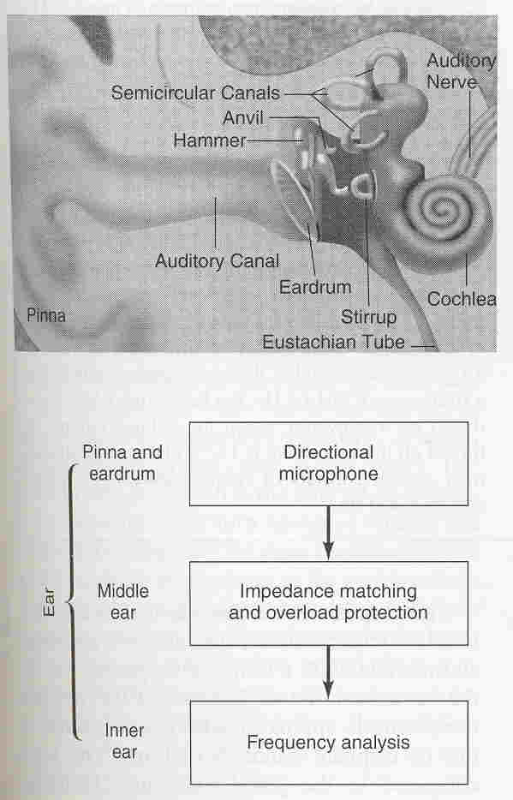
The Ear – The Big Picture

Slide 4
The Ear – The Big Picture
Outer & Middle Ear
The outer ear comprises the pinna, auditory canal, and eardrum.
The middle ear is the air-filled chamber between two membranes - the eardrum and the oval window.
The middle ear contains the three smallest bones in the body, and these are called the ossicles.
Malleus (hammer) is attached to the eardrum.
Incus (anvil) is bound by ligaments to the malleus and to the stapes.
Stapes (stirrup) is bound to and strikes against the oval window, like a bass drum pedal.
Here’s a diagram of the middle ear….

Slide 5
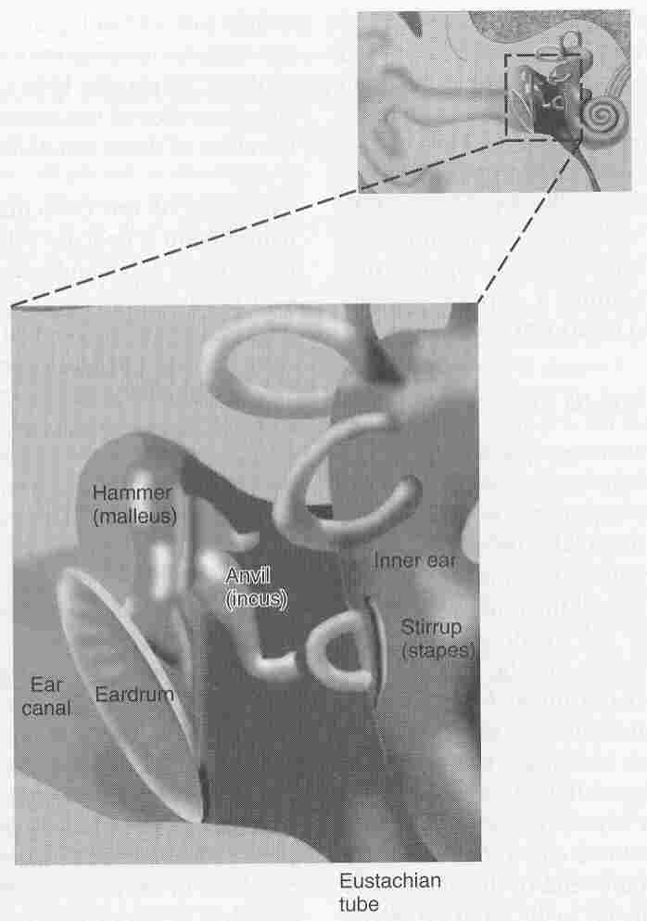
Middle Ear

Slide 6
The Ear – The Big Picture
Middle Ear
One function of the middle ear is “overload protection”.
Overload protection is granted by the acoustic reflex, which stiffens the ear drum and restricts the ossicles’ movement.
This prevents shootin’ your ear out!

Slide 7
The Ear – The Big Picture
Middle Ear
Another function of the middle ear is impedance (i.e., resistance) matching.
That is, the fluid-filled inner ear is more resistant (has greater impedance) than the air-filled middle ear: Sound would be lost if it were not amplified by the middle ear.
Amplification is achieved by the ossicles, and by forcing the vibrations from the large eardrum onto the much smaller oval window.
The oval window is part of the inner ear structure called cochlea….

Slide 8
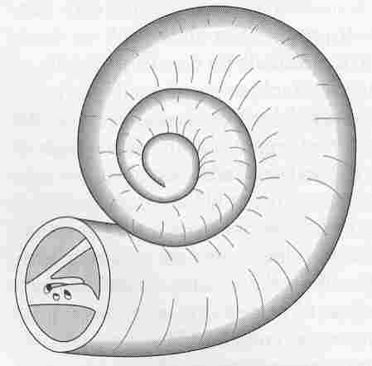
The Inner Ear: Cochlea
Cochlea is the Greek word for “Snail”.
The cochlea is ~the size of a pea.

Slide 9
The Inner Ear: Cochlea
Let’s uncoil the snail-shaped cochlea

Slide 10
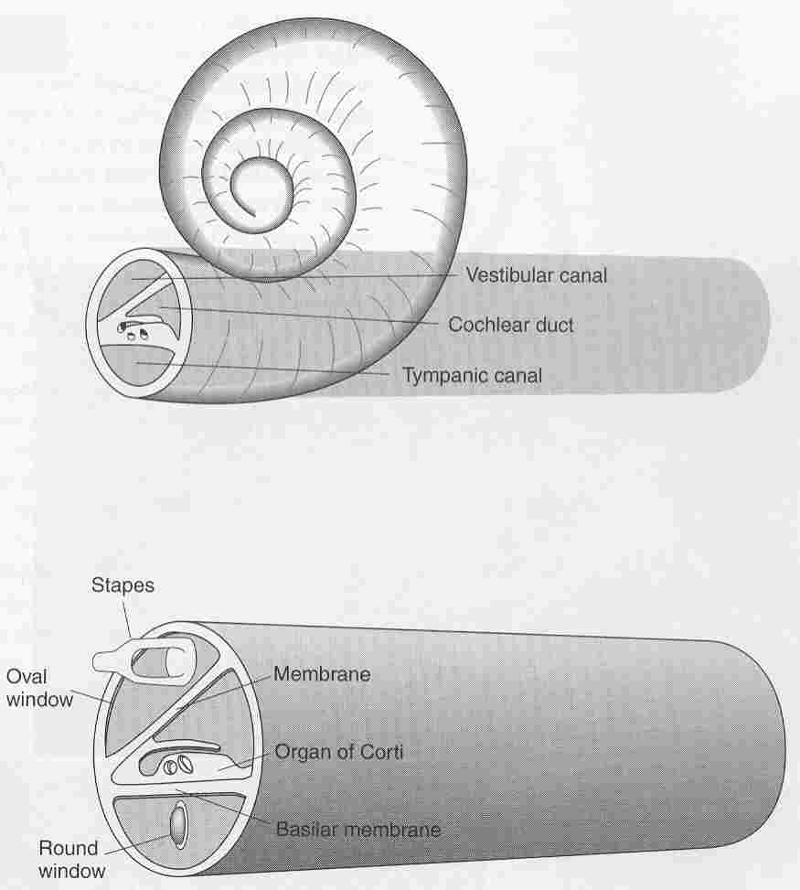
Cochlea “Unplugged”
We’ll
limit our
discussion to
these two
structures.

Slide 11
Cochlea “Unplugged”
Organ of Corti & Basilar Membrane
The organ of Corti sits on top of the basilar membrane.
You might use this memory trick…. “basilar membrane” has a ‘b’ and ‘m’, so it’s on the bottom, so the organ of Corti must be on top.
More specifically, the portion of the organ of Corti that makes contact with the basilar membrane is called the tectorial membrane….

Slide 12
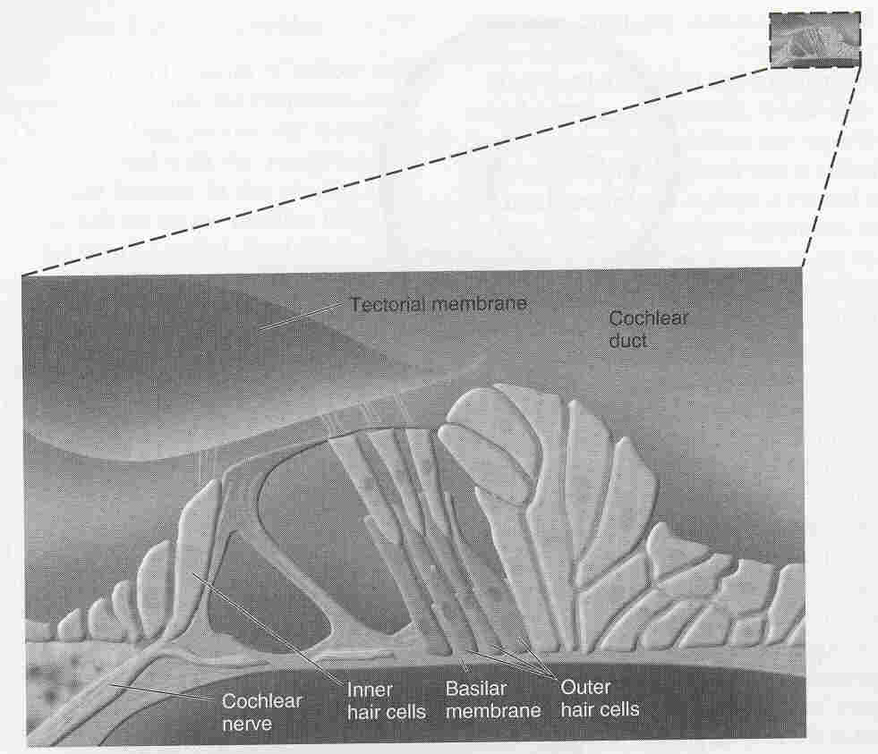
Inner Ear: Organ of Corti
The tectorial
and basilar
membranes
slide back and
forth each other,
bending the
hair cells (the
receptors).

Slide 13
Inner Ear: Organ of Corti
The bending
triggers electrical
changes in the
hair cells.
This generates the
release of neuro-
transmitters.
(A little like a
“Cis-Trans”
isomerization.)

Slide 14
Cochlea “Unplugged”
Some Facts About Hair Cells
Hair cells are the receptors for hearing, and they come in two varieties; inner and outer hair cells.
In each ear, there is one row of (~3,500) I.H.C.s, and three rows of O.H.C.s (totaling ~12,000 O.H.C.s) .
Both types of hair cells contain bristle-like structures on their tops, as shown here…

Slide 15
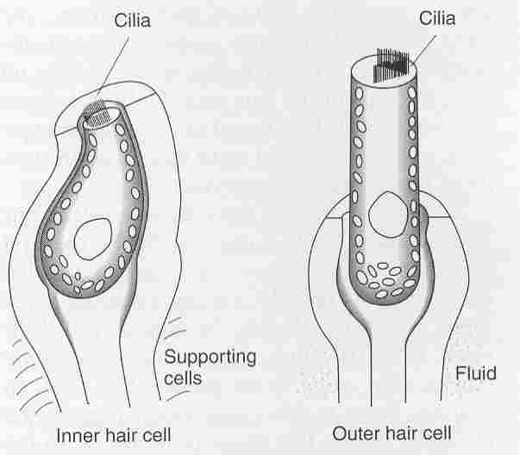
Inner & Outer Hair Cells (1)
The bending
occurs in the
cilia, not the
whole cell.

Slide 16
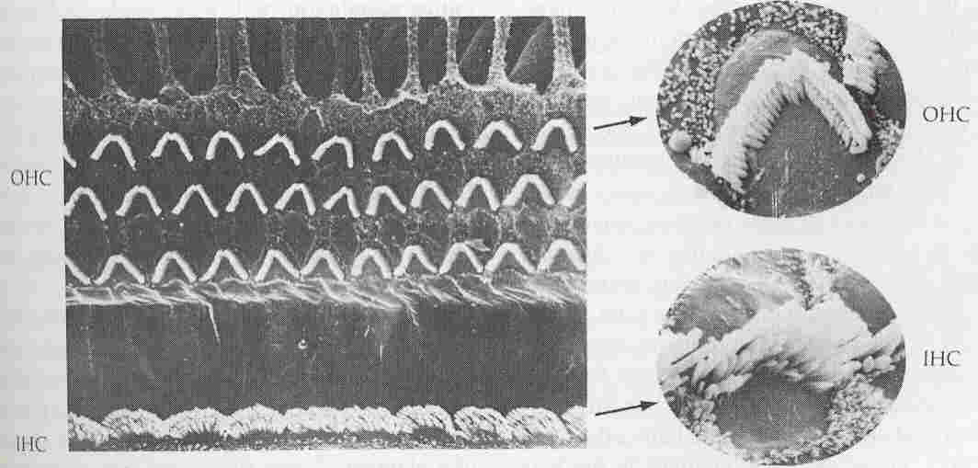
Inner & Outer Hair Cells (1)
Note the 3 rows of OHC, versus the 1 row of IHC.

Slide 17
Cochlea “Unplugged”
Some Facts About Hair Cells
Even though the O.H.C.s (~12,000) out number the I.H.C.s (~3,500), the I.H.C.s enjoy “most favored hair cell status”. ;-)
That is, of the 30,000 auditory nerve fibers that carry the signals between the cochlea and the brain, only 5% of these fibers are linked to O.H.C.s.
So, 95% auditory nerve fibers “take their orders” from the I.H.C.’s.
Although the O.H.C. activity makes a comparatively small DIRECT contribution, O.H.C. activity makes a large INDIRECT contribution by affecting the output of I.H.C.s.
There are two main ideas about how inner-ear activity could code frequency. The first is temporal theory….

Slide 18
Frequency Coding
The Temporal Theory
Temporal theory originally posited that the higher frequency, the greater the number of action potentials in the cochlea.
One limitation of the theory is that each neurons have refractory period of about 1 ms: This means that we couldn’t hear frequencies greater than 1,000 Hertz.
To circumvent this problem, temporal theory was modified to “Volley Theory”.
Volley theory posits that a group of neurons could have inter-leaved responses that could achieve rates greater than 1,000 Hertz.
Let’s see what this might look like…

Slide 19
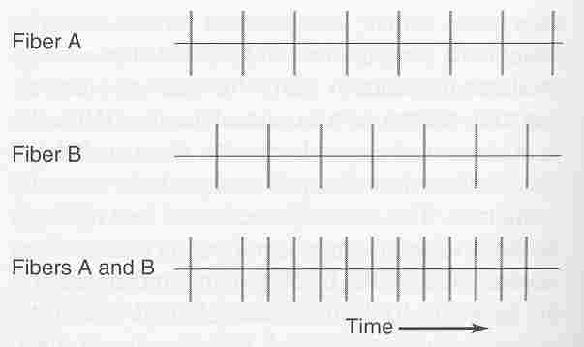
Volley Theory

Slide 20
Frequency Coding
Volley Theory
Still, Volley Theory might depend on one neuron that “supervises” the other inter-leaved responses, and this “supervisor” would have it’s own refractory period of 1 ms (i.e., 1,000 Hz).
So, Temporal Theory and Volley Theory could be true, but most likely at low frequencies only.
To code higher frequencies, Place Theory has been proposed…

Slide 21
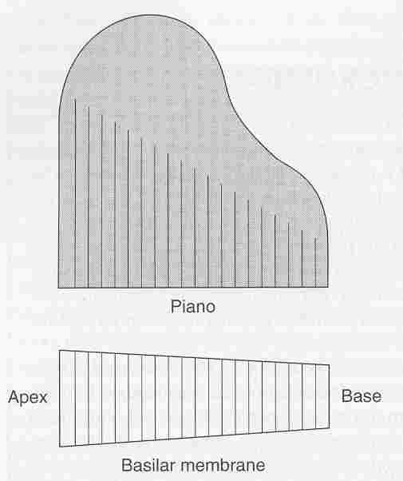
Basilar Membrane & Piano
Place Theory
holds that a
traveling wave
of excitation
is maximal at
different PLACES
on the basilar
membrane.

Slide 22
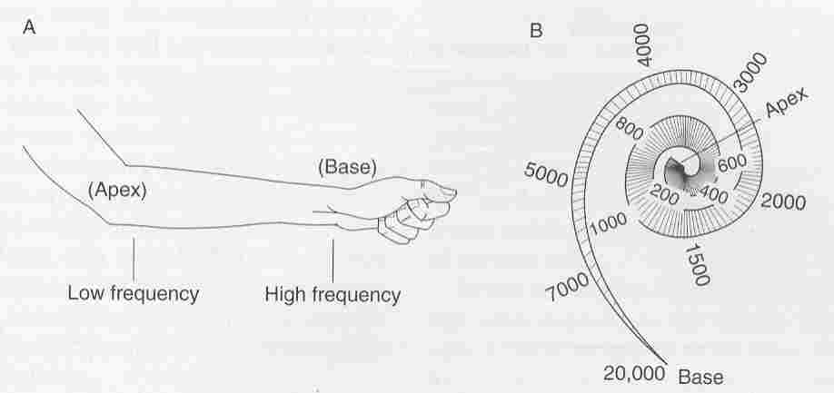
Place Theory
Low frequencies at apex: High frequencies at base.
(So it’s backwards because base is not bass.)

Slide 23
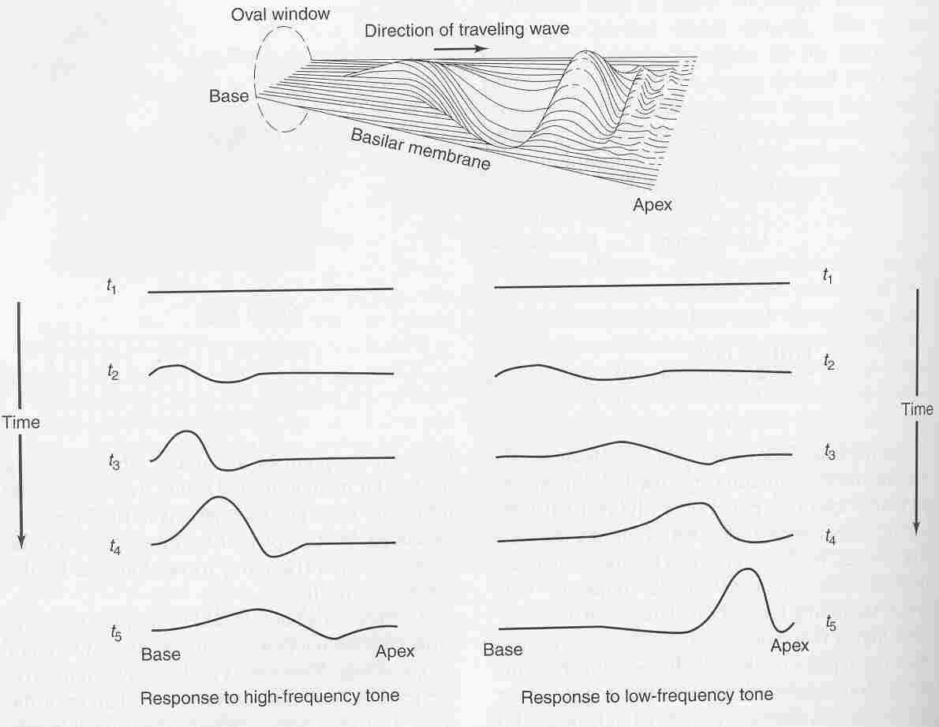
The Traveling Wave

Slide 24
Central Auditory Pathways
The auditory nerves make there way to the Medial Geniculate Nucleus. (This is similar to the optic nerve going to the Lateral Geniculate Nucleus.)
Neurons in the MGN project to the primary auditory cortex, “A1”. (Again, this is similar to LGN to V1).
In A1 (and in the superior olive) some neurons receive input from both ears.
These are called binaural neurons, and they help us to localize sounds (just like binocular neurons help us to localize visual stimuli.).
Here’s how a binaural neuron might be innervated to respond to the position of auditory stimuli…

Slide 25
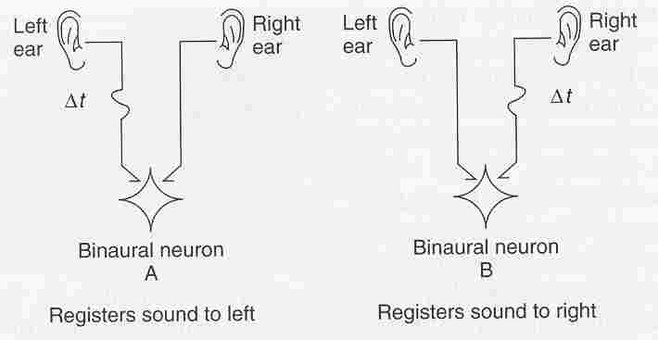
Binaural Neuron
“Coincidence Detector”

Slide 26
Central Auditory Pathways
Just as V1 is retinotopic, area A1 is “tonotopic”.
That is, the positions of various frequencies represented in A1 correspond to positions back in the basilar membrane.
Now let’s see how our sensitivity to various frequencies and intensities might depend on the response of auditory neurons….

Slide 27
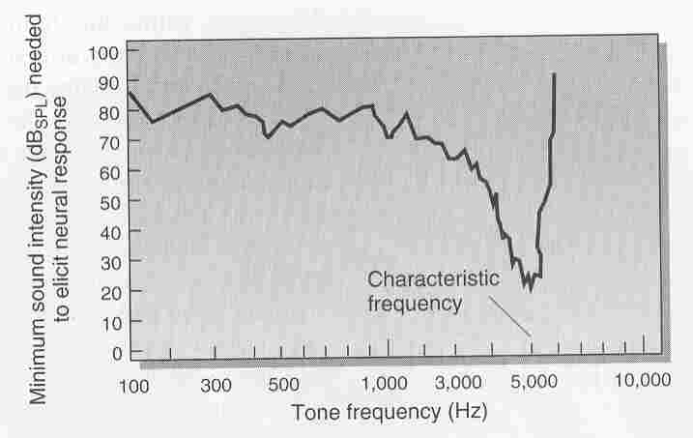
Threshold Versus Frequency

Slide 28
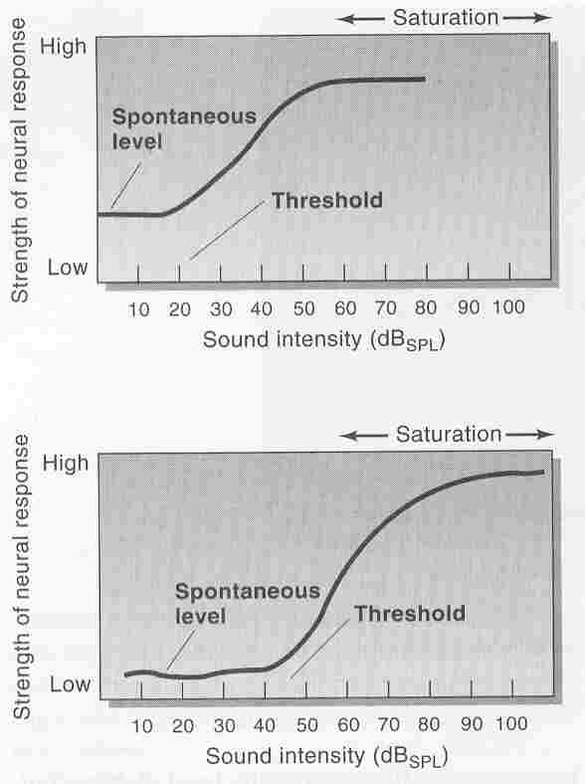
Intensity Coding

